Slide 1
Indoor Wi-Fi positioning
IOT Analytics

Slide 2
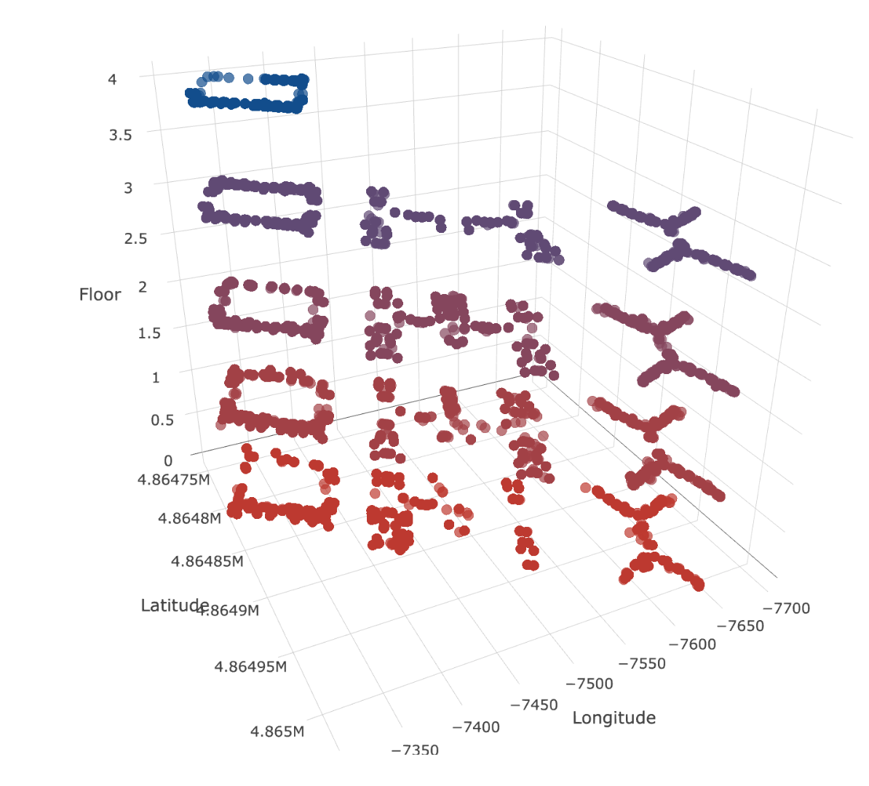
Data Context:
3 buildings located in Universitat Jaume I.
2 data sets with identical variables, but collected at different time periods to achieve independency.
Training set - 19,937 registers, the participants had to perform captures in specific reference points.
Validation set – 1,111 registers, the participants had to perform captures without having any set reference points.

Slide 3
Data Cleaning:
Remove duplicated captures – total of 637 duplicates were found in the training set, 0 duplicates in the validation set.
Exponential rescaling of RSSI values of WAP signals.
Removing WAPs with near zero variance.
Removing rows which had no signal present.
Removing WAPs that were registered in multiple buildings, possibly due to a time difference between when training and validation sets were collected, e.g.WAP248 that was present in all 3 buildings.
No missing values were found.

Slide 4
Feature Engineering:
Creating new variables named StrongWap and StrongRSSI, which store the strongest WAP identifier per capture and the highest RSSI value. StrongWap is used as an independent variable to predict the Building ID with 100% accuracy.
A combined variable BUILDING_FLOOR that stores both Building ID and corresponding Floor number.

Slide 5
Modeling:
Building ID Model: h20 Random Forest model, using only the StrongWap variable as a predictor. Trained on the training set and tested on the validation set. Accuracy = 1.
Longitude Model: RF model per each building using parallel processing (not h20) and all WAPs (including StrongWap) as predictors.
Latitude Model: RF model using all WAPs, same configuration as for longitude.
Floor model: RF model using all WAPs + previously predicted Longitude and Latitude.
RF model: | RMSE | R^2 | MAE
Building 0 | 7.07 | 0.93 | 4.67
Building 1 | 9.64 | 0.96 | 6.71
Building 2 | 10.84 | 0.88 | 7.06
RF model: | RMSE | R^2 | MAE
Building 0 | 5.52 | 0.97 | 3.88
Building 1 | 10.78 | 0.91 | 7.57
Building 2 | 9.38 | 0.90 | 6.52
RF model: | Accuracy | Kappa
Floor | 0.91 | 0.88

Slide 6
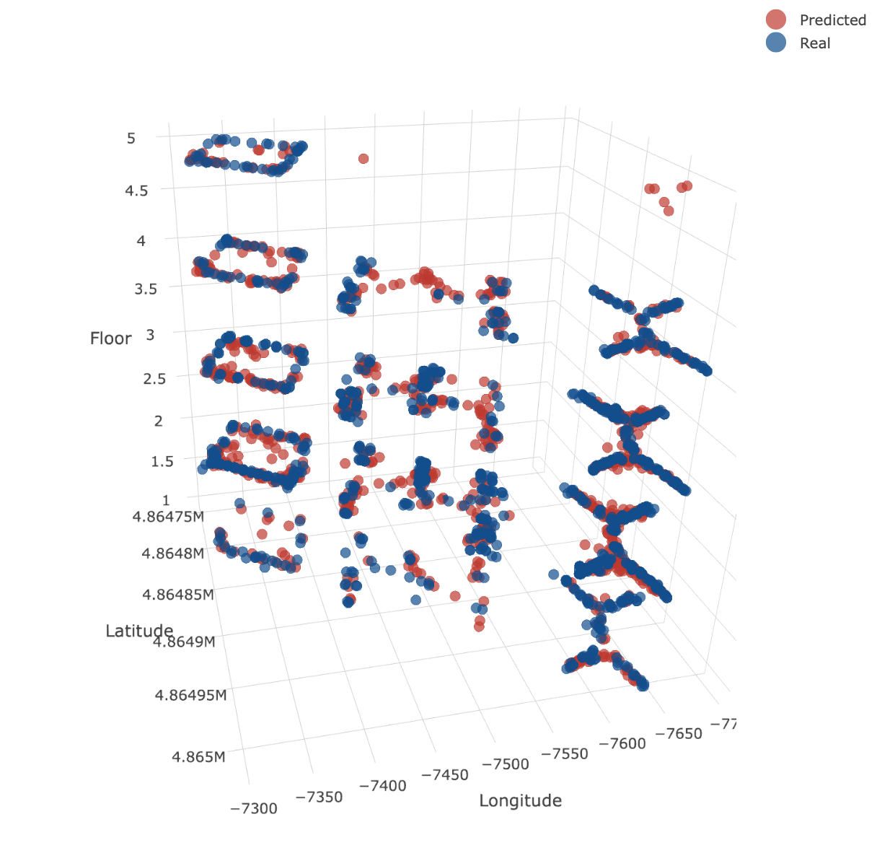
Conclusions and Future Plans:
Overall, it is possible to achieve good enough accuracy by only using WAP signals to determine location, but there is still room for improvement.
i.e 1

